Slide 1

AFR Quality Control
SPREAD Course 2016

Slide 2
Agenda: Key elements of an AFR quality control concept
AFR Quality Management
Clear AFR/Waste specifications
Documented AFR source qualification process
Waste acceptance control on daily basis
Adequate sampling/control plans
Adequate sampling regime
Laboratory facilities and equipment
2

Slide 3
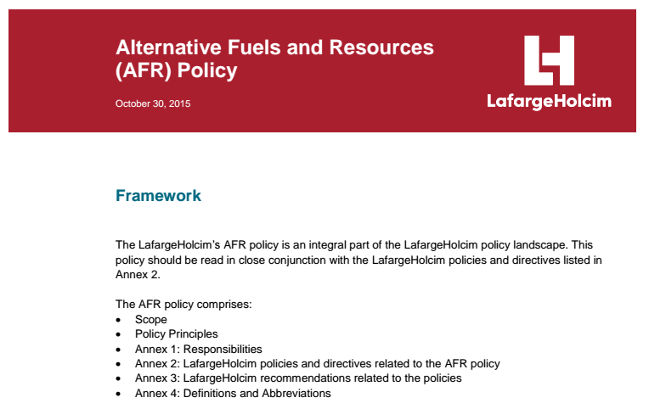
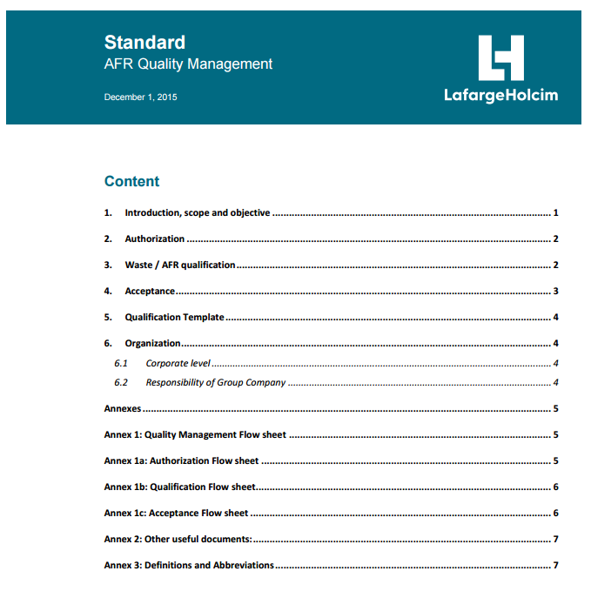
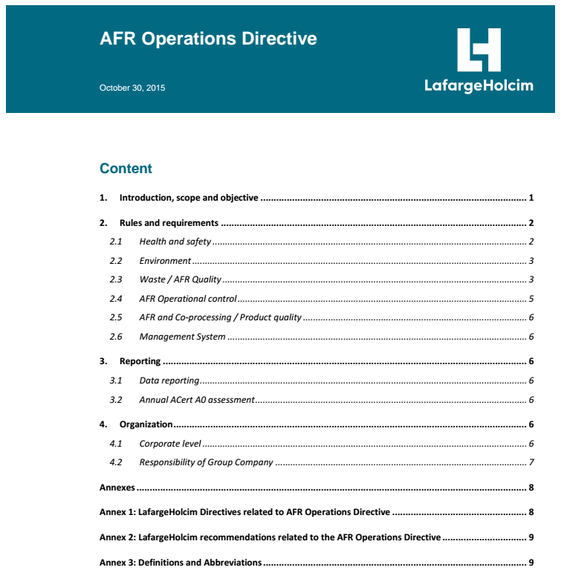
AFR Quality Management - general frame
PRINCIPLES
REQUIREMENTS & RECOMMENDATIONS
REQUIREMENTS
3

Slide 4
Quality Management flow-sheet
4

Slide 5
Authorization flow-sheet
5

Slide 6
Qualification flow-sheet
6

Slide 7
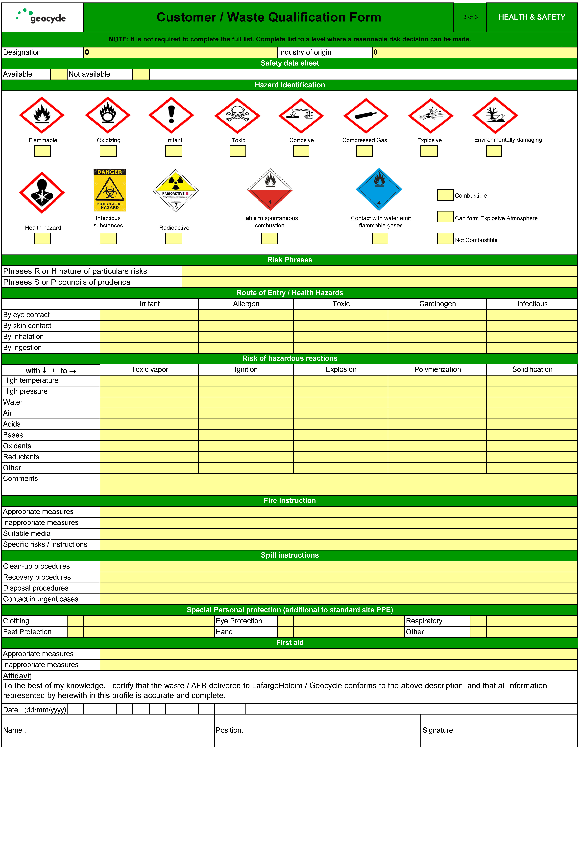
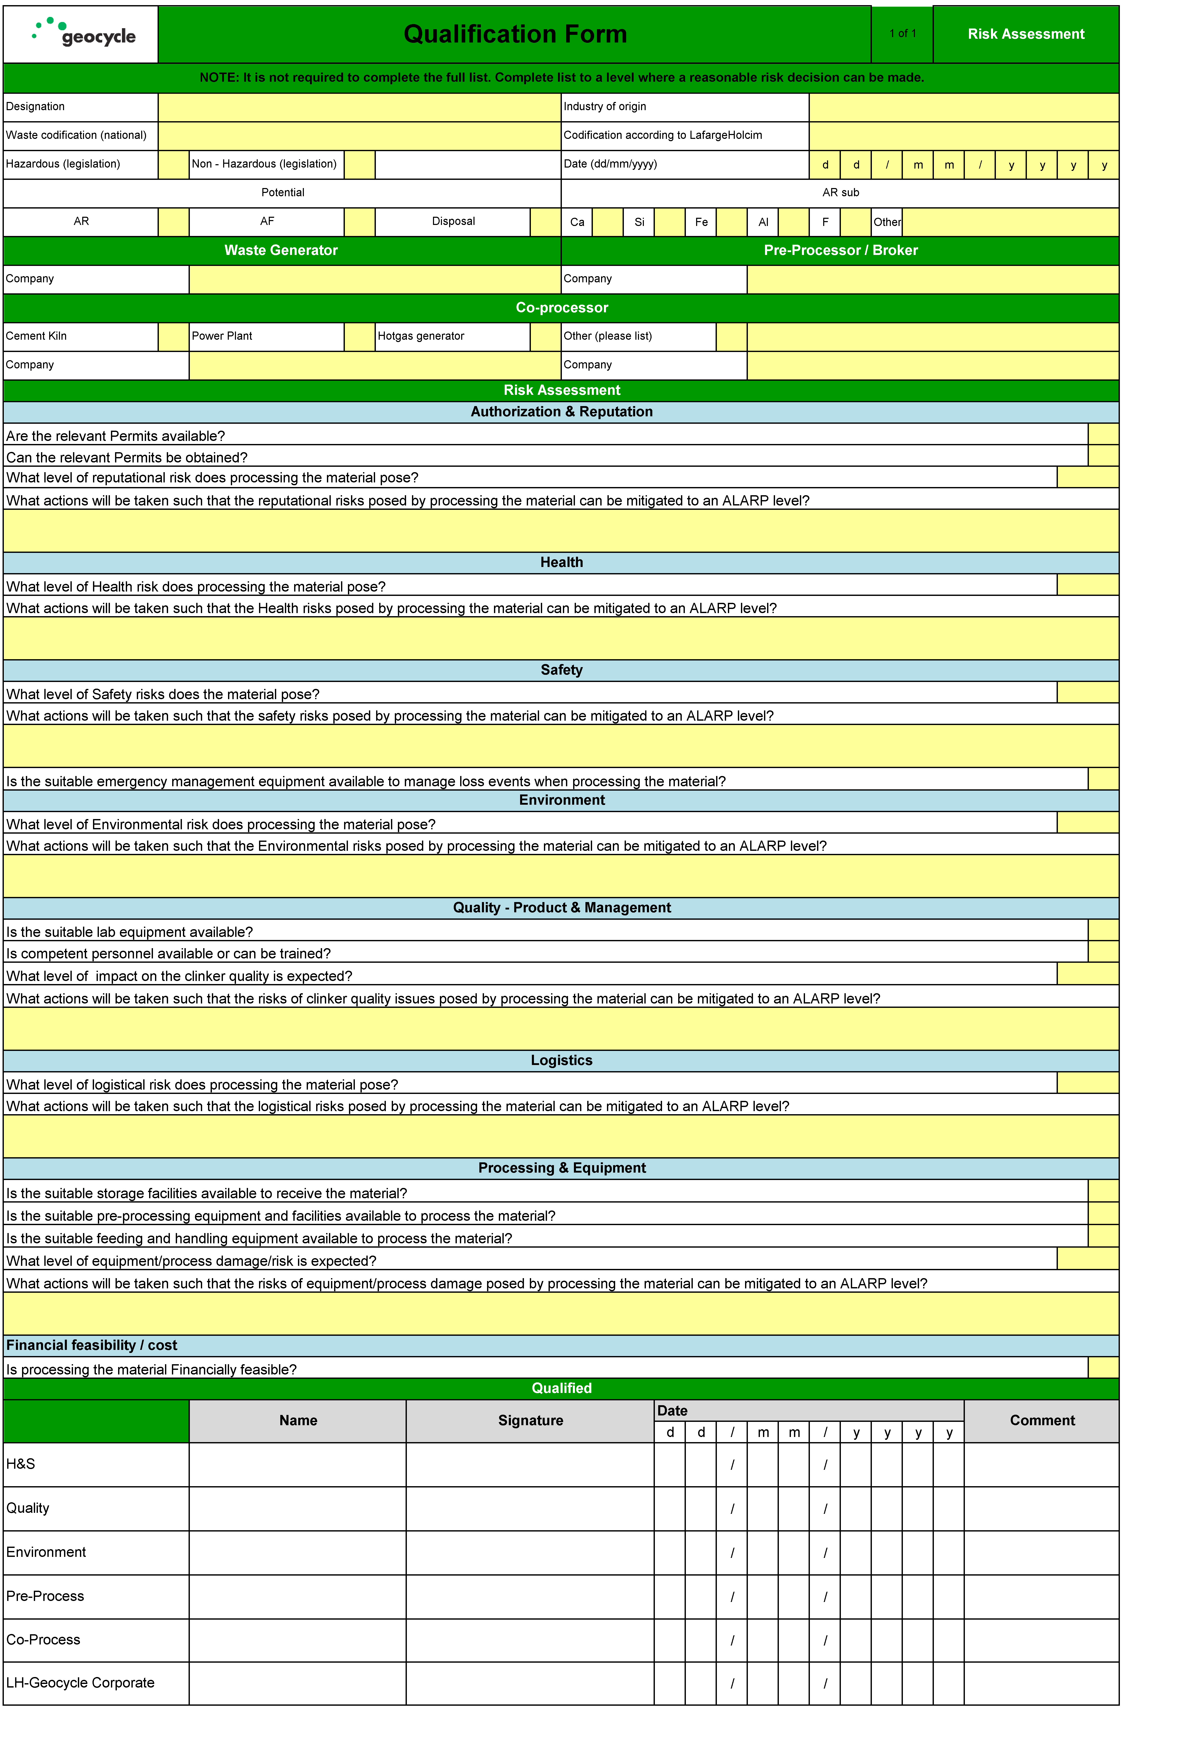
The AFR Qualification Template can be used to compile a detailed Qualification for any AFR / Waste

Slide 8
Acceptance flow-sheet
8

Slide 9
Agenda: Key elements of an AFR quality control concept
AFR Quality Management
Clear AFR/Waste specifications
Documented AFR source qualification process
Waste acceptance control on daily basis
Adequate sampling/control plans
Adequate sampling regime
Laboratory facilities and equipment
9

Slide 10
AFR quality control concept: Direct deliveries to plant
10

Slide 11
AFR quality control concept with pre-processing
11
11

Slide 12
Drawing up plant specific Waste/AFR Specifications
Operational Requirements (plant specific)
Plant Operation
Clinker / Cement
Quality
Waste/AFR Specifications
Health
& Safety
Environmental
Impact
Legal Requirements (Operating Permits)
12

Slide 13
Legal and LH requirements
Legislative and regulatory frameworks of countries, where co-processing is applied, need to be respected.
Waste incineration directives
Laws on environmental protection
Specific guidelines for AFR preparation and co-processing, e.g.
BAFU guidelines “Disposal of wastes in cement plants”
RAL GZ 724
CSI Guidelines for Co-Processing Fuels and Raw Materials in Cement Manufacturing
Individual operating permits
LafargeHolcim specific requirements
AFR Policy (updated October 2015)
AFR Operations Directive
AFR Quality Management Standard
13
Notes:
BAFU - Bundesamt für Umwelt (Switzerland)
RAL GZ 724 – Quality Assurance for SRF (Germany)

Slide 14
AFR Policy: Banned wastes
LafargeHolcim Group Companies further commit that the list of "banned wastes" will not be processed
Radioactive waste
Asbestos-containing waste
Explosives and ammunition / weapons
Self-reactive / thermally unstable compounds / organic peroxides exhibiting explosive properties
Anatomical and infectious health care waste
Nor will LafargeHolcim Group Companies co-process
Electronic fraction of electrical and electronic waste (e-waste)
Whole batteries as a targeted material stream
Waste of unknown or unpredictable composition, including unsorted municipal waste
14

Slide 15
Example CH: Guidelines for wastes to be co-processed in cement plants, referring to trace elements
 | Guidelines [mg/kg dry basis ]
 | Combustibles (AF) |  | Raw material (AR) | MIC
 | [mg/MJ] | [mg/kg] (at 25MJ/kg) | [mg/kg] | [mg/kg]
As | 0.6 | 15 | 20 | 30
Sb | 0.2 | 5 | 5 | 5
Ba | 8 | 200 | 600 | 1000
Be | 0.2 | 5 | 3 | 3
Pb | 8 | 200 | 50 | 75
Cd | 0.08 | 2 | 0.8 | 1
Cr | 4 | 100 | 100 | 200
Co | 0.8 | 20 | 30 | 100
Cu | 4 | 100 | 100 | 200
Ni | 4 | 100 | 100 | 200
Hg | 0.02 | 0.5 | 0.5 | 0.5
Se | 0.2 | 5 | 1 | 5
Ag | 0.2 | 5 | - | -
Tl | 0.12 | 3 | 1 | 2
V | 4 | 100 | 200 | 300
Zn | 16 | 400 | 400 | 400
Sn | 0.4 | 10 | 50 | 30
15

Slide 16
Example: Waste acceptance criteria at the AFR platform in Spain
Total Halogens | ≤10 %
F | ≤ 2%
S | ≤ 10%
Hg | ≤ 10
Cd | ≤ 1000
Tl | ≤ 100
Sb | ≤ 100
As | ≤ 200
Co | ≤ 400
Ni | ≤ 2000
Cu | ≤ 5000
Cr | ≤ 5000
V | ≤ 10’000
Pb | ≤ 15’000
Sn | ≤ 25’000
Mn | ≤ 15‘000
PCB‘s | ≤ 30
Acceptance criteria at platforms can be significantly different than acceptance criteria at a plant gate.
16

Slide 17
Besides legal and LH requirements, plants need to define AFR acceptance criteria based on their specific operational limits
Type of process (kiln type, precalciner, bypass installation,…)
Potential limits on Cl, SO₃, alkalis, moisture, NCV, granulometry
Handling and storage facilities
Potential limits on flashpoint, viscosity, granulometry, pH
Type of products (clinker, cement) and product quality
Potential limits on ash content, ash composition (e.g. P₂O₅), alkalis, mineralogical composition

Slide 18
Quality Agreements: Example Fluff
Often statistical concepts such as median, or percentiles are used. This is to compensate for the low precision, that a single measurement may have.
Example: Trace element limits are defined as 80 percentile → 4 out of 5 samples need to be below the limit.
18

Slide 19
Non-normal distribution of heavy metals in wastes
19

Slide 20
Agenda: Key elements of an AFR quality control concept
AFR Quality Management
Clear AFR/Waste specifications
Documented AFR source qualification process
Waste acceptance control on daily basis
Adequate sampling/control plans
Adequate sampling regime
Laboratory facilities and equipment
20

Slide 21
Waste source qualification procedure
Several steps:
Identification of customers/materials by commercial department
Evaluation of existing information (process type, characteristics, etc.)
Full scale testing of a representative sample
Negotiation
Approval by all involved parties
Commercial Agreement
Several “players”
Commercial Department
Quality, Environmental, Safety Department
Production Department
Laboratory (also external)
21

Slide 22
Key factors to avoid negative surprises are captured in the Waste source qualification
Demand maximum of information from supplier on
Process characteristics
Candidate waste properties
Visit installations and take samples yourself
Do not accept waste based on insufficient, unsatisfactory or claimed but not received information
Create a comprehensive “master file” of the candidate AFR
Communication: Discuss with company experts (technical manager, H&S manager, commercial dept. etc.)
Establish a good supply contract (volumes, quality, prices)

Slide 23
AFR Waste Qualification Master File (QMF)
The Master file should contain information on
General data: Designation of waste, source, volumes, availability, macroscopic properties and composition
Chemical and physical properties: Chemical composition, flash point, viscosity, granulometry, etc.
H&S Information: Required protection, first aid, etc.
Handling and application: Pre-treatment, storage, extraction, feeding point, etc.
23

Slide 24
Agenda: Key elements of an AFR quality control concept
AFR Quality Management
Clear AFR/Waste specifications
Documented AFR source qualification process
Waste acceptance control on daily basis
Adequate sampling/control plans
Adequate sampling regime
Laboratory facilities and equipment
24

Slide 25
AFR acceptance concept: The daily business
25

Slide 26
AFR/Waste Acceptance Control: Objectives
Take decision for AFR shipment acceptance or rejection
Verify that delivered material meets operating and permit specifications
Ensure compliance with internal H&S requirements (workers and equipment safety)
Keep records for future inquiries, allegations, liabilities
Establish service fees
26

Slide 27
Agenda: Key elements of an AFR quality control concept
AFR Quality Management
Clear AFR/Waste specifications
Documented AFR source qualification process
Waste acceptance control on daily basis
Adequate sampling/control plans
Adequate sampling regime
Laboratory facilities and equipment
27
27

Slide 28
Establishing meaningful control plans (1)
Objectives | Measures
Ensure conformity with legal / permitting requirements | Fingerprint testing (critical properties) on reception Weekly / monthly testing on composite samples Adoption of official guidelines for sampling, where appropriate
Ensure conformity with process requirements | Fingerprint testing on reception Daily testing of key parameters in processed AFR (H₂O, flash point, CV, ash, Cl, S)
Avoid multiple sampling and testing | Establish relationship between AFR producer and user. Agree on control plan at producer and user. Make use of: certification mutual visits / audits accompanying delivery documents
28

Slide 29
Establishing meaningful control plans (2)
Objectives | Measures
Adapt to material properties and risks involved | Limit testing of well-known, non-critical material
Adapt sampling plan to observed statistics | Start with “high-frequency” testing; reduce according to observed uniformity / conformity with specification
Ensure most representative sample | Appropriate sampling location
Centralize “reference” testing | Regional AFR-laboratories with specialized equipment and analytical expertise (ICP / AAS / GC etc.)
29

Slide 30
Example of and AFR control plan for main burner fuel
Source qualification
Source qualification: complete analysis
Acceptance control: Mostly visual and moisture
Batching/Mixing: H₂O, ash content for process control
Feeding points: H₂O, cal. val., ash content for quality assurance. Full analysis on weekly composite.
Org. Sludges
Saw dust
Rice Husk
Textiles, Plastics
PPF:
Impregnation
IMSD
Plant gate
Mixing
Drying
Geocycle at plant
Plant operation
30

Slide 31
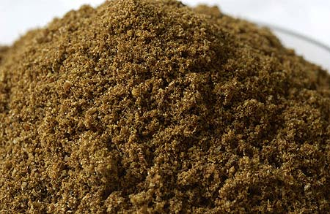
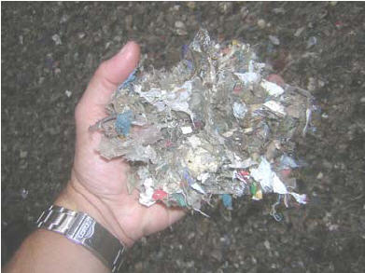
Quiz: Critical properties and control plans for …
Animal meal
Control Parameter | Frequency
RDF (main burner quality)
Control Parameter | Frequency
31

Slide 32
Quiz: Critical properties and control plans for …
Animal meal
Control Parameter | Frequency
Calorific value | On delivery
Moisture | On delivery
P₂O₅, Cl | Composite (weekly)
Ash content | Composite (monthly)
S, Trace elements | Composite (monthly)
RDF (main burner quality)
Control Parameter | Frequency
Moisture | On delivery
Calorific value | On delivery
Cl | On delivery
Granulometry (3D particles) | Weekly composite
Trace elements, Hg | Weekly composite
32

Slide 33
Agenda: Key elements of an AFR quality control concept
AFR Quality Management
Clear AFR/Waste specifications
Documented AFR source qualification process
Waste acceptance control on daily basis
Adequate sampling/control plans
Adequate sampling regime
Laboratory facilities and equipment
33
33

Slide 34
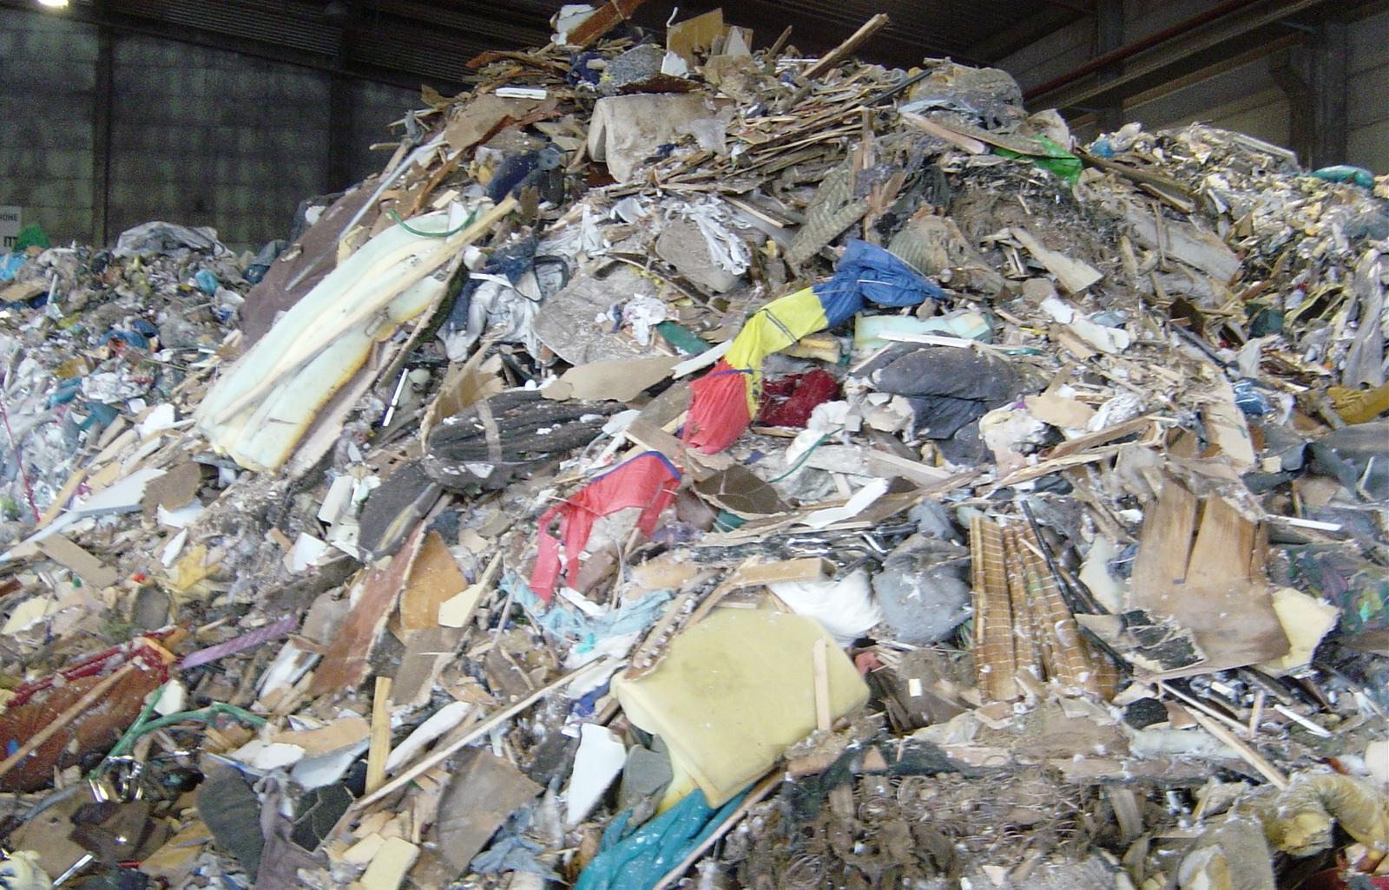
(Representative) AFR/Waste sampling
Inhomogeneity; Excessive lump size
Inaccessibility of static material
Segregation, Stratification
34

Slide 35
Sources of errors during AFR testing
Sample
Preparation
40 %
55 %
Sampling
5 %
Analytical
Instrument
35

Slide 36
Strategies to reduce sampling error
Increase mass of sample
Increase number of increments (“cuts”)
Reduce particle size (shredding, grinding)
The variance of the fundamental error is directly proportional to the size of the largest particle and inversely proportional to the mass of the sample
Composite sampling from different locations
For very inhomogeneous material: Pre-sorting and separate sampling/analysis
Choose appropriate sampling location and sampling tools
36

Slide 37
Sampling location vs. representativity
Representativity
Mechanical sampling from output stream - transfer chute
Mechanical from conveyor belt
Mechanical from stopped belt
Manual from output stream
Manual from truck/train
Manual from pile / storage
37

Slide 38
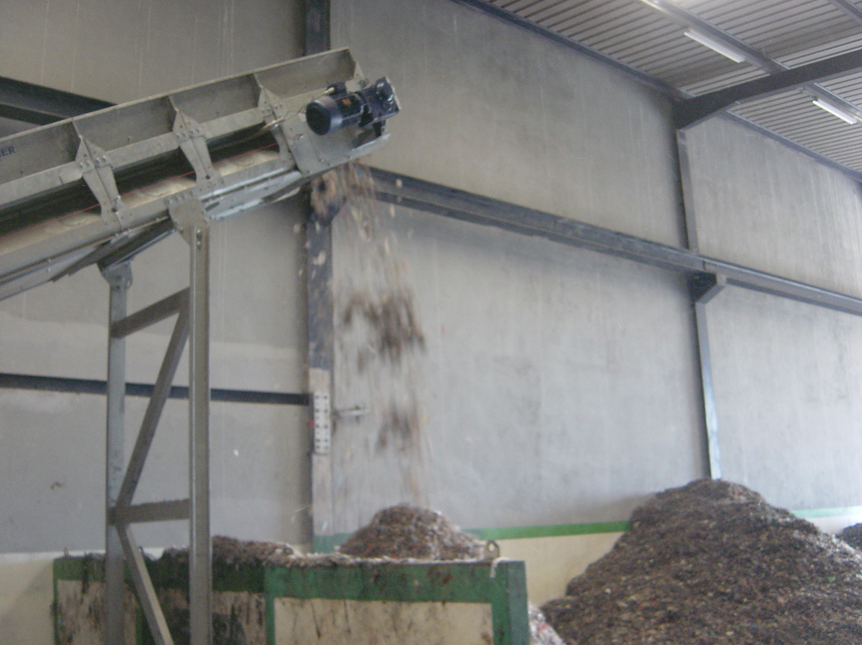
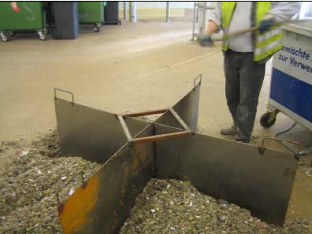
Sampling shredder output, sample size reduction
2 l
38

Slide 39
Required sample mass – Standard EN 15442
(At least 24 increments)
CEN/TS 15442: Standard for sampling solid recovered fuels
39

Slide 40
Minimum mass of sample
d₉₅: Nominal particle size (95% of mass passing) [mm]
s: Form factor [mm³/mm³]. Calculated as max. volume of a particle (l x w x h) divided by max. length (l) of a particle to the power of 3. ≤ 1
λ: Bulk density [g/cm³]
g: Particle size distribution factor, according to ratio d₉₅/d₀₅ (0.25 -1)
p: Number of particles with property of interest [g/g], e.g. for RDF
NCV: 0.1 (default)
Cl: 0.02
Cd: 0.002
C_{v}: Coefficient of variation (fundamental sampling error); Guide value 0.1.
40

Slide 41
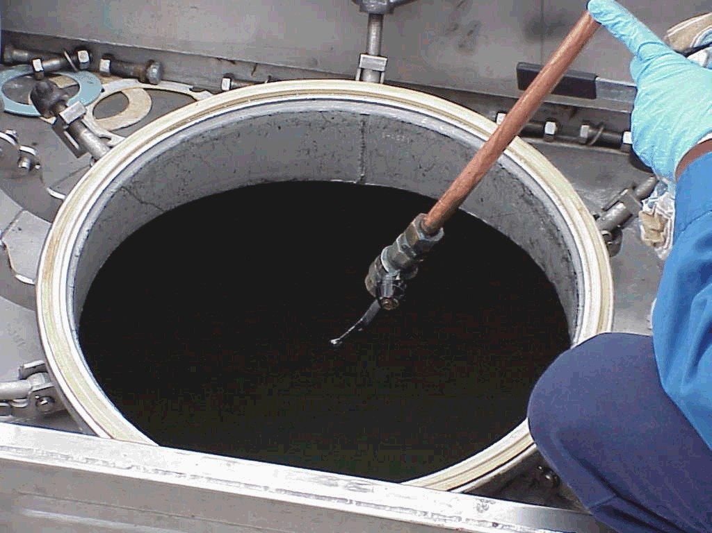
Sampling of bulk liquids
41

Slide 42
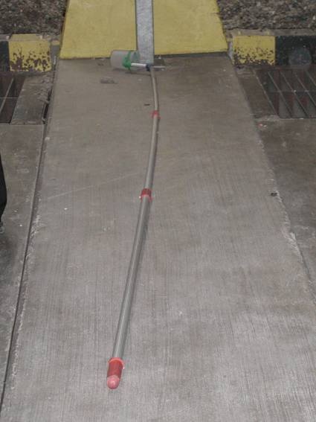
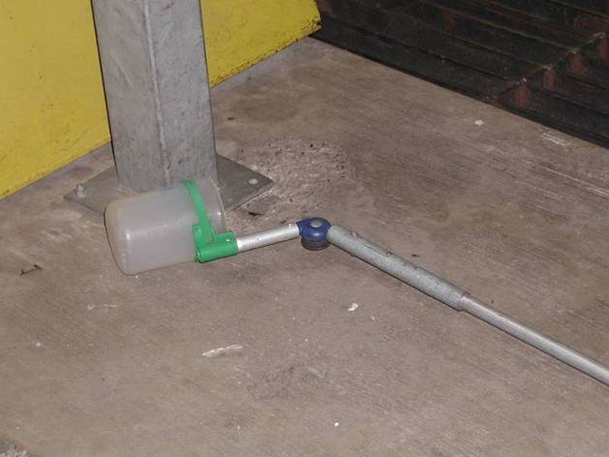
Sampling of bulk solids
42

Slide 43
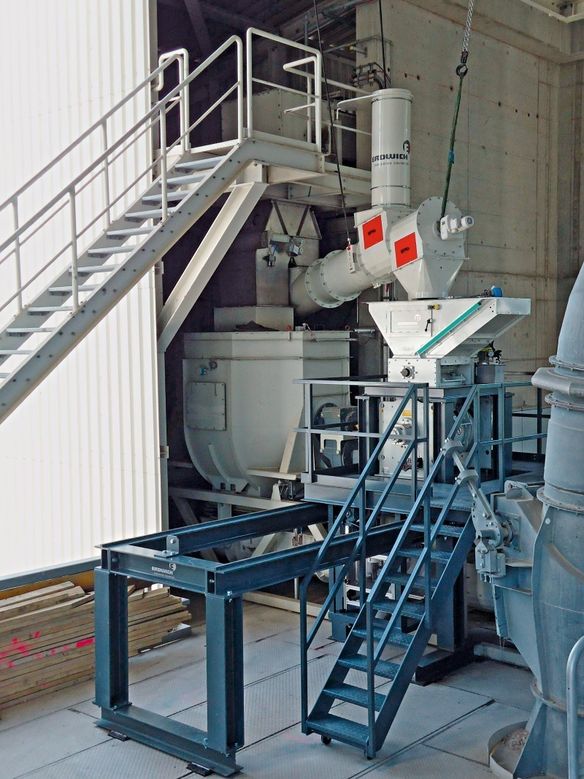
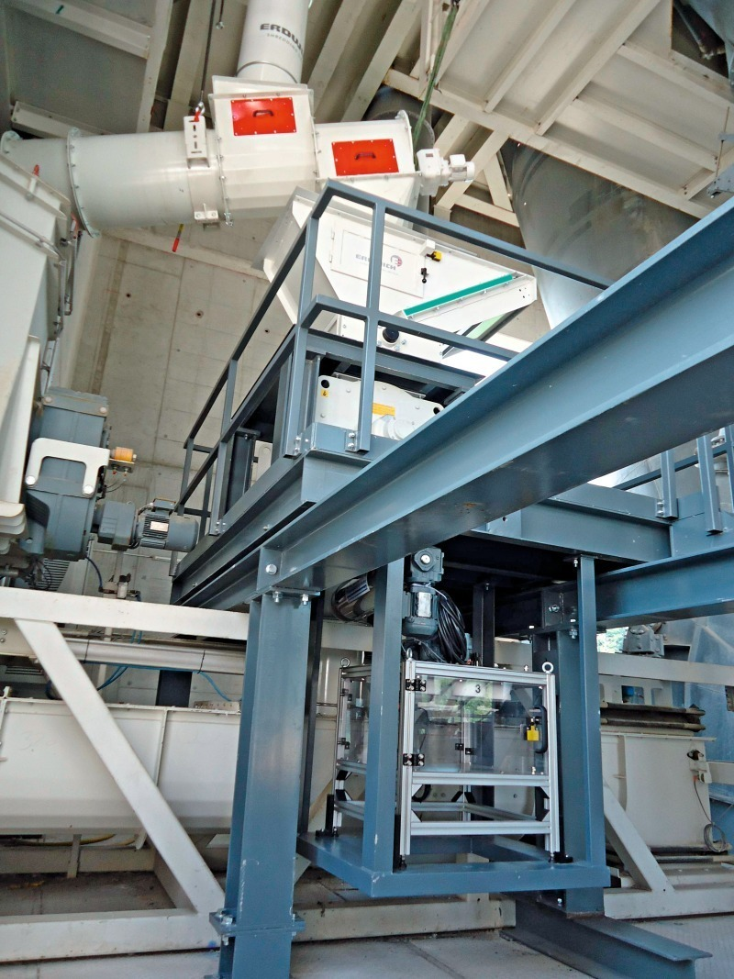
Automated RDF sampling
Leube cement plant, Austria [Source: ZKG International, 2013(2), 16.]
43

Slide 44
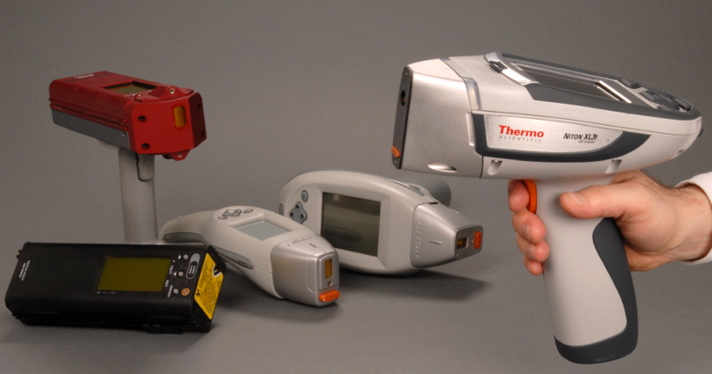
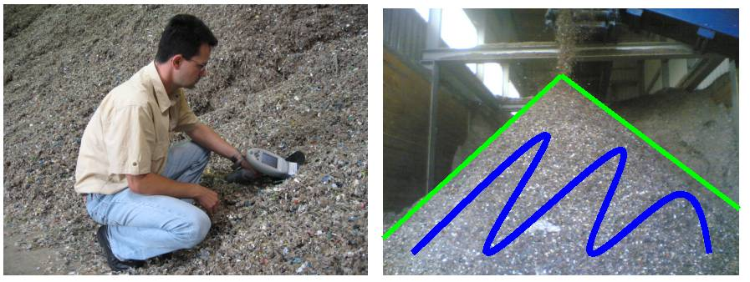
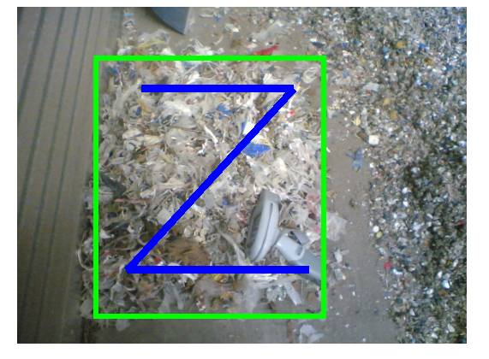
Portable XRF – no need for sampling?
Suppliers: Thermo/Niton, Oxford, Spectro (ca 30k€)
average of e.g. 20 measurements
Ca. 10-30 sec per measurement
Main application: Heavy elements, potentially Cl
Sample preparation is important
44

Slide 45
Agenda: Key elements of an AFR quality control concept
AFR Quality Management
Clear AFR/Waste specifications
Documented AFR source qualification process
Waste acceptance control on daily basis
Adequate sampling/control plans
Adequate sampling regime
Laboratory facilities and equipment
45
45

Slide 46
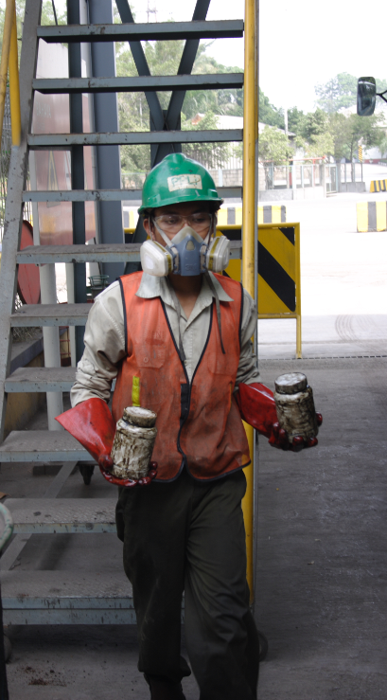
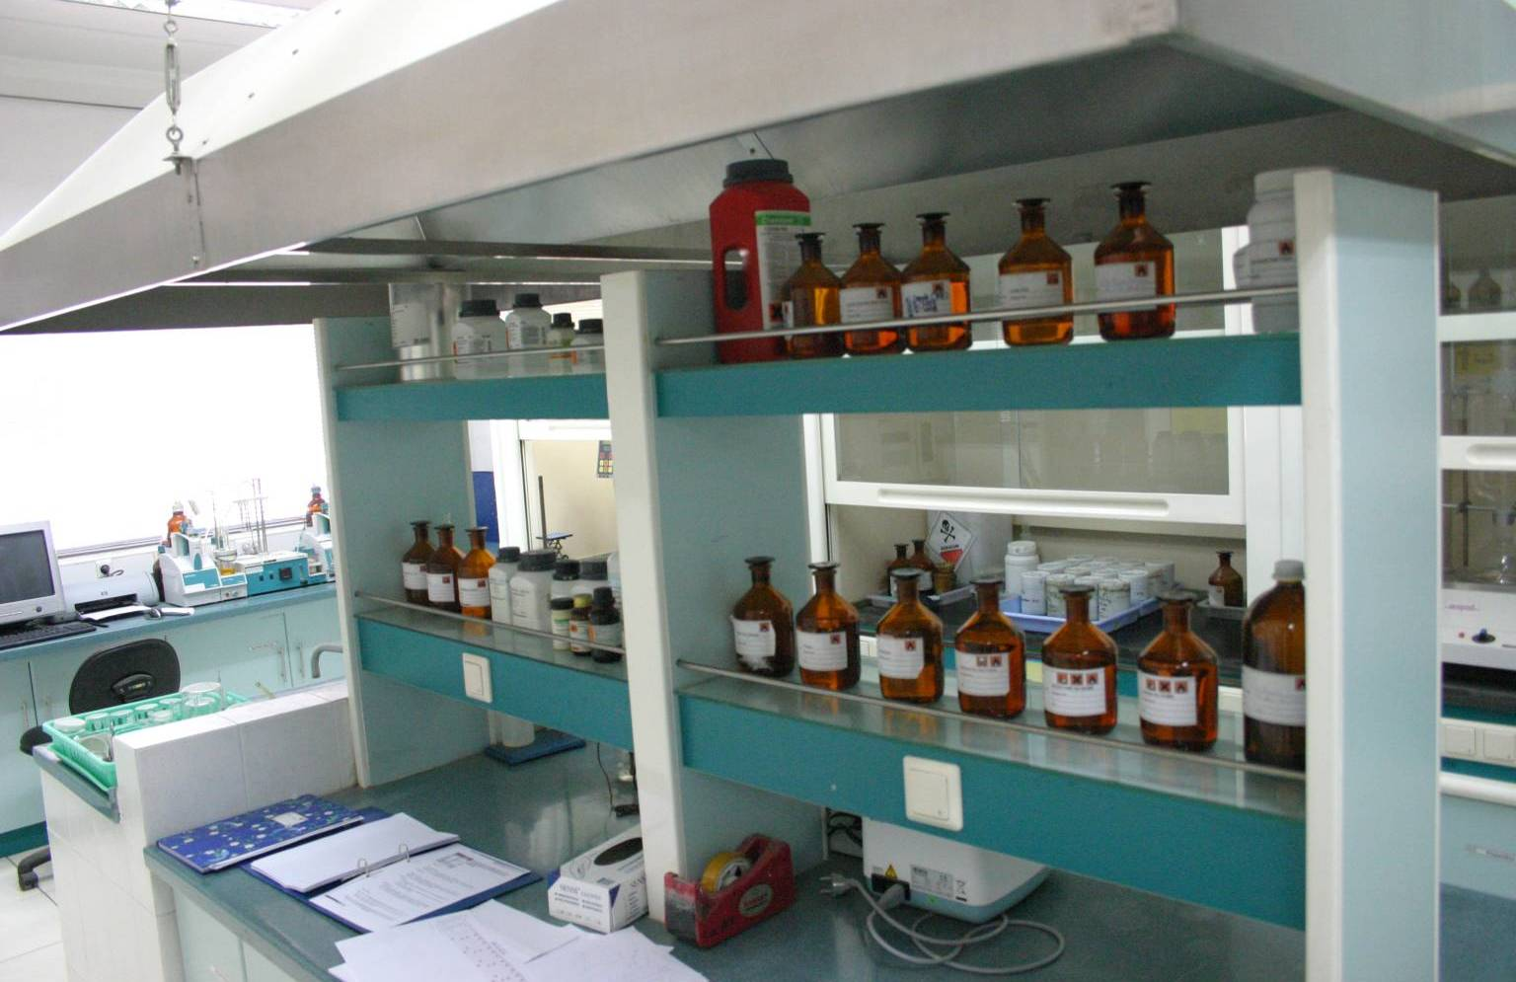
The AFR laboratory
Organic and potentially toxic materials
Unknown samples
Comply with permissions, regulations and standards
Special analytical procedures (speed)
46

Slide 47
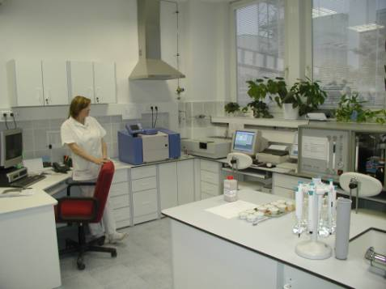
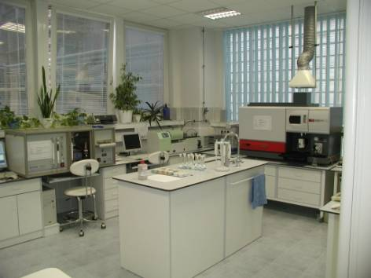
A neat AFR-laboratory is a promotion instrument

Slide 48
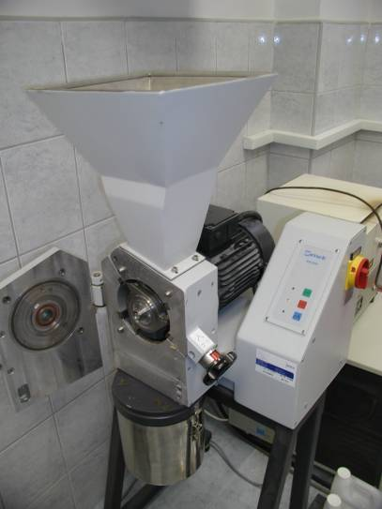
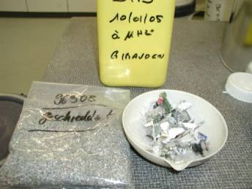
Size reduction is first step in sample preparation
Possible Applications: Plastics, rubber, paper, solid biomass
For plastics: Operate under liquid nitrogen / solid CO₂ cooling.
48

Slide 49
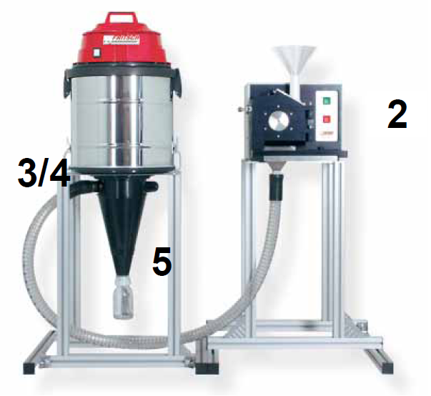
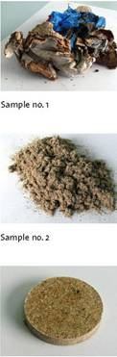
Example: Sample preparation of Fluff (for XRF analysis)
Cutting mill in combination with cyclone (ca. 16‘000 €)
49

Slide 50
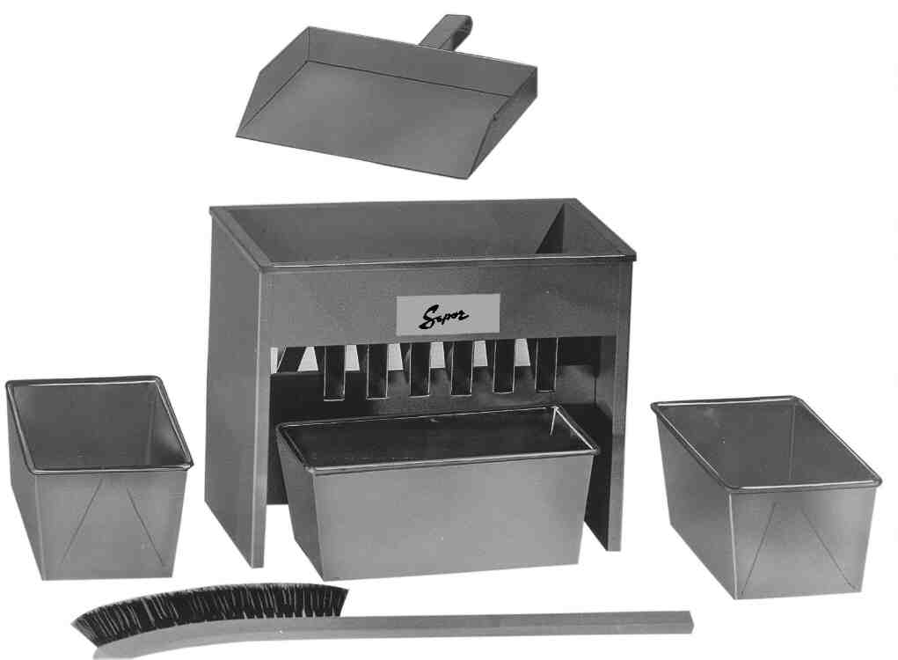
Sample mass reduction (manual)
Mechanical splitter (Riffle type)
Coning & Quartering
First size reduction (comminution) then mass reduction.
50

Slide 51
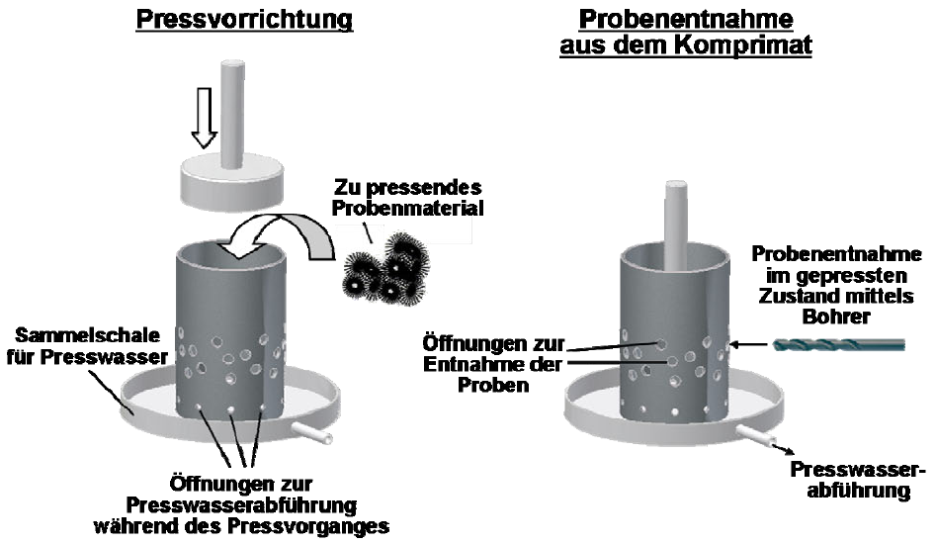
More sophisticated techniques are developed
51

Slide 52
Main task: Analysis
Which properties do we have to determine ?
What equipment do we need?
Physical measurements: CV (Calorific Value), Flash point
Equipment: Bomb Calorimeter, FP-Analyzer
pH, water content
Equipment: pH-Meter, Karl-Fischer-Apparatus
S, Cl, Halogens
Equipment: S-Analyzer, Electrode/Titrator
PCB, CN, Organics
Equipment: Gas-Chromatograph with diff. Detectors
Heavy metals (Cd, Tl, Pb, Hg, Cr etc.…)
Equipment: ICP, AAS, EDXRF
Chemical compatibility
…
52

Slide 53
Minimum requirements for AFR laboratories at plants
Basic AFR | Equipment | Parameter | Price ca.(€)
 | Bomb calorimeter incl. vessel | Calorific value | 20k - 35k
 | Titration equipment for potentiometric titration | Cl | 5k
 | Moisture analyzer (hot plate, oven) | Moisture | 2k
 | UV/VIS photometer (or S/C analyzer) | SO₃ | 2k
 | Sieves | Granulometry
+ liquids | Equipment | Parameter | Price ca. (€)
 | Karl Fischer titration equipment | Water content | 8k
 | Viscosimeter | Viscosity | 4k
 | Flash point analyzer | Flash point | 3k up
+ SRF, RDF,… | Equipment | Parameter | Price ca. (€)
 | Rotor mill, Cutting mill or similar | Sample prep. | 10k up
 | Potentially: Muffle furnace | Ash content | 3k
53

Slide 54
Minimum requirements for AFR platform laboratories
All of the equipment in cement plant labs
+ balances, fume hoods, water purification, …
AFR platform | Equipment | Parameter | Price ca.(€)
 | Gas chromatograph with Mass spectrometer / FID / ECD | Organic compounds, PCB‘s | 60k – 150k
 | Microwave assisted digestion | Sample prep. | 15k up
 | ICP-OES | Trace elements | 60k -100k
 | and/or ED-XRF | Trace elements ,ash composition | 60k
 | Scintillation detectors (mobile/ stationary) | Radioactivity | 2k / 20k up
 | Ion selective electrode | F | 5k
 | S/C Analyzer | SO₃, total carbon | 25k – 40k
 | AAS based Mercury analyzer | Hg | 25k
54

Slide 55
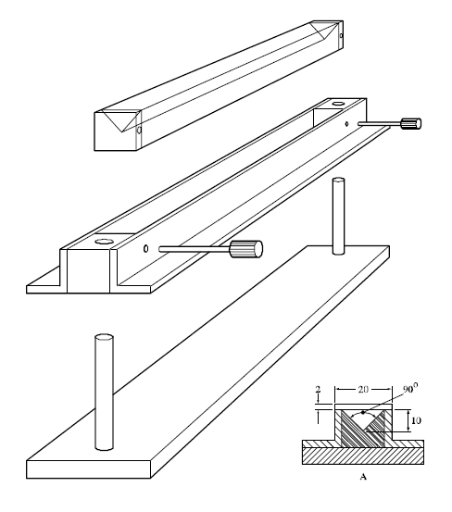

Flammable vs non-flammable - Burning rate test
Classification flammable vs non-flammable (Design safety of AFR installation).
The test measures the rate at which a flame propagates along a pile of material shaped in a defined way
Source: UN Manual of Tests and Criteria, part III, section 33, which is part of the Recommendations on the Transport of Dangerous Goods.

Slide 56
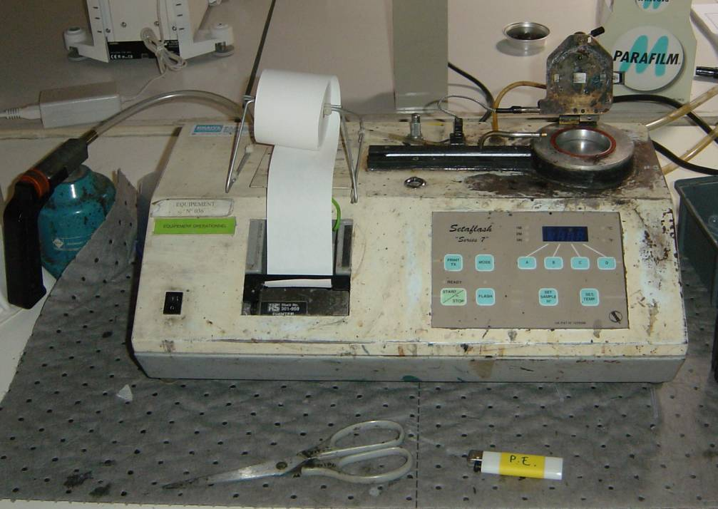
Flash point determination – Closed / Open Cup
Closed cup testers simulate situations of confined storage space.
Gives a lower (safer), more precise result and are less affected by laboratory conditions than open cup testers.
For routine testing a ‘flash / no flash’ decision at the temperature of interest is ok.
In case of high sample throughput, consider installing two instruments (with heated and cooled cups)

Slide 57
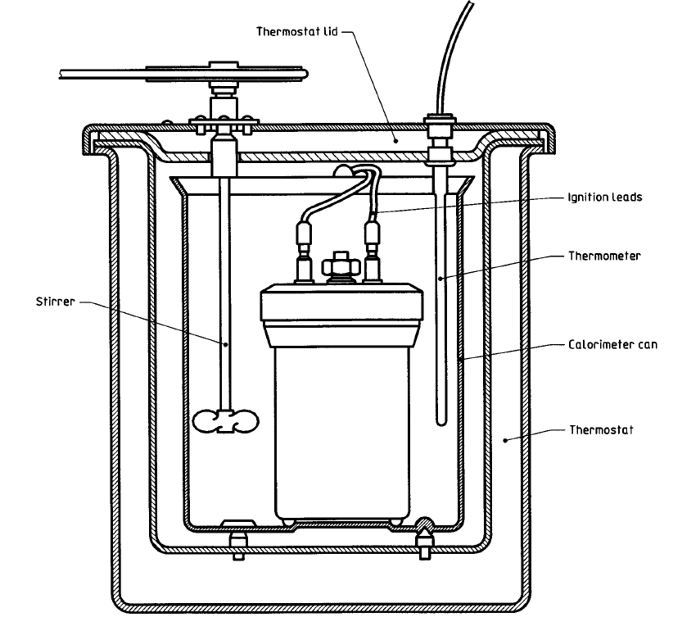
Calorific value determination - Bomb Calorimeter
The calorific value is a measure for the amount of heat released during combustion, expressed in J/g (kJ/kg; MJ/t).
It is a fundamental parameter for cement industry (STEC, CO₂ reporting, etc)
The bomb calorimeter can only measure the gross calorific value (GCV).

Slide 58
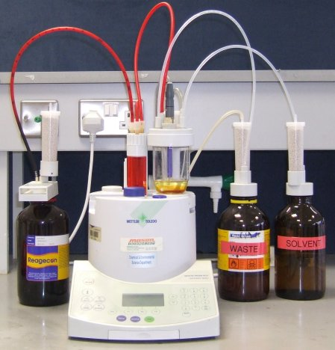
Moisture determination - Karl Fischer titration
Principle reaction: Water reacts stochiometrically with iodine and sulfur dioxide:
I₂ + SO₂ + 2H₂O 2 HI + H₂SO₄
If no side reactions occur (e.g. reactions with Aldehydes/Ketones), the KF titration is the quickest and most accurate method to determine water content.
However, the water must be brought into solution. This can be difficult for non-soluble materials (e.g. oils). Auxiliary solvents might be required (Chloroform, Toluene, etc).
The reaction vessel must be protected against atmospheric moisture.
For solids: For solid samples they can be combined with special furnaces which drive out the moisture into the reaction vessel

Slide 59
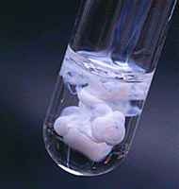
Halogenide content - Potentiometric titration
Fully automatic and accurate measurement of halogenide concentrations.
Principle: Precipitation of halogenides with silver-salts and measuring conductivity.
Cl⁻ + Ag⁺ AgCl (solid)

Slide 60
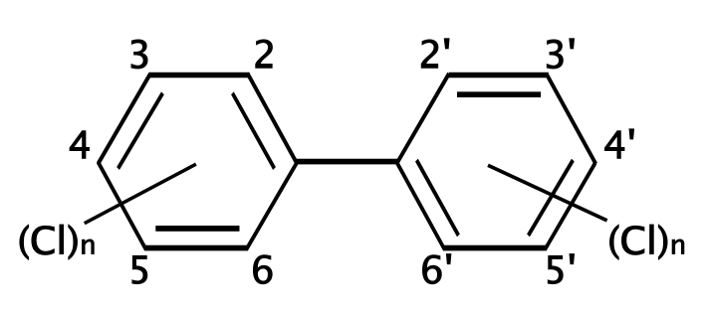
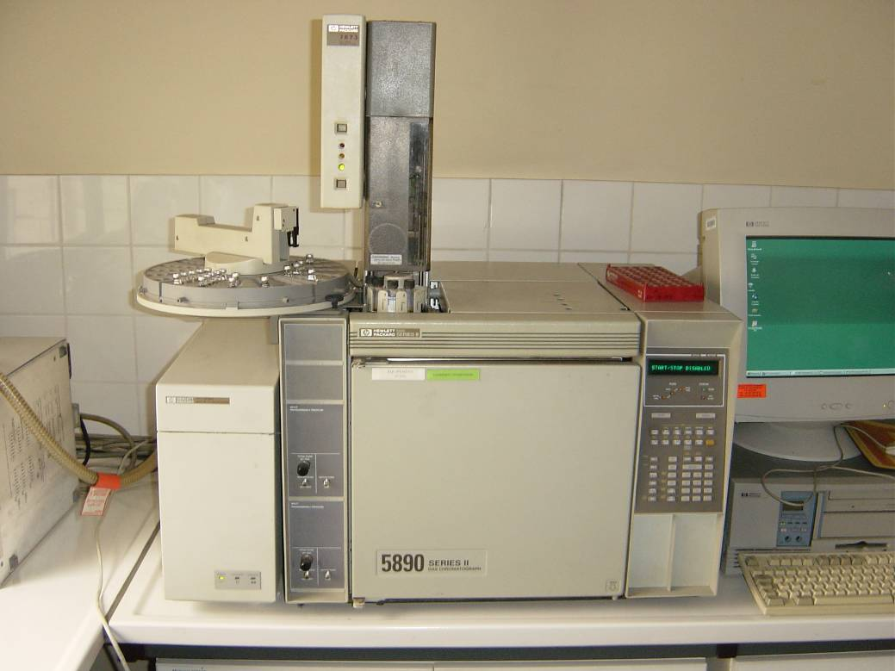
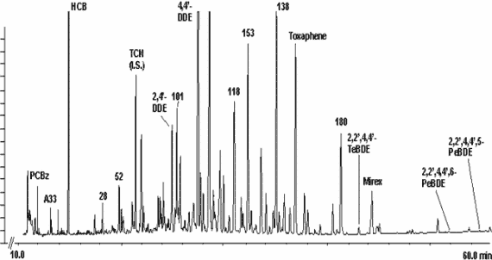
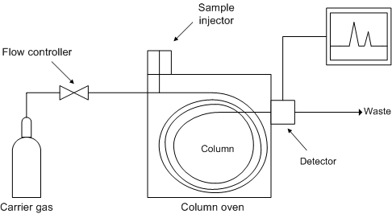
PCB‘s (Poly Chlorinated Biphenyls): Determination – Gas Chromatograph
Chronically toxic, suspected to cause cancer, hormonal effects, enrichment in natural food chain.
Precursor for Dioxins in combustion processes.
Extraction from sample by organic solvents (hexane)
Detection with gas chromatograph, equipped with ECD or MS.
Identification by comparison with reference standard (containing selected congeners)
ASTM D6160-98, DIN EN 15308
Organic
Aqueous

Slide 61
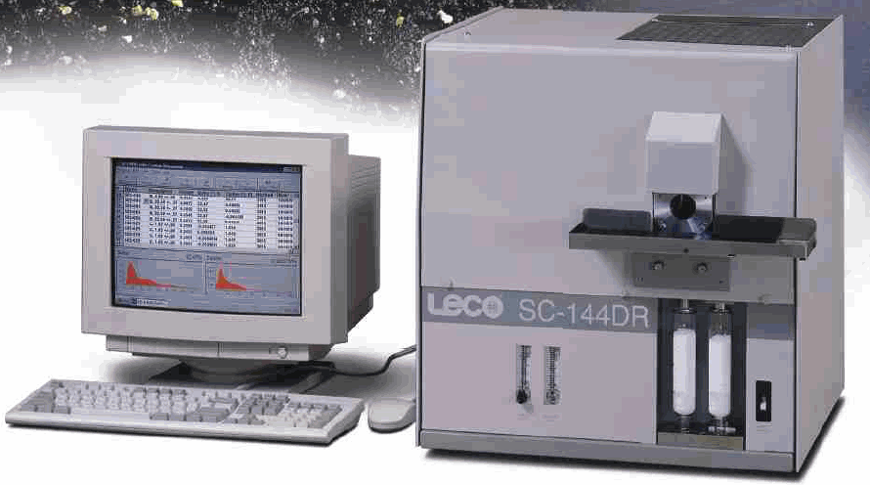
Determination of Sulphur and Carbon - Leco SC-144 DR
Principle
Total combustion:
C to CO₂ and of
S to SO_{x} with V₂O₅ or WO₂
in a oxygen atmosphere.
CO₂ and SO_{x} are measured in IR-cells.
Accurate and fast determination of sulfur concentrations. No sample preparation is needed.
Applications: Raw Materials and Fuels
C from 0 - 100% (cov +/- 0.3% at 5-100 %),
SO₃ from 0 - 10% (cov +/- 0.2% at 10 %),
SO₃ from 10 - 100% .

Slide 62
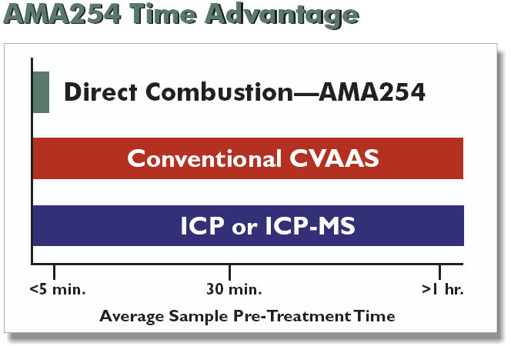
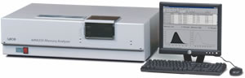
Mercury
Several methods:
AMA-254 [Leco], DMA [Milestone, Inc.] (EPA Method 7473)
AAS cold vapor
ICP-MS
Standards for calibration
NIST 1633b (0.141 ppm)
NIST 2704 (1.44 ppm)
NIST 2711 (6. 25ppm)
NIST 2710 (32.6 ppm)

Slide 63
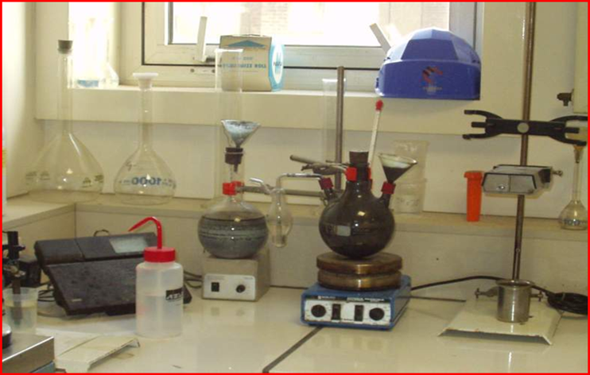
Chemical compatibility
Required when different wastes are mixed on a large scale:
Different types of liquid fuels mixed and stored in a common tank
Different reactive chemical wastes blended together (impregnation)

Slide 64
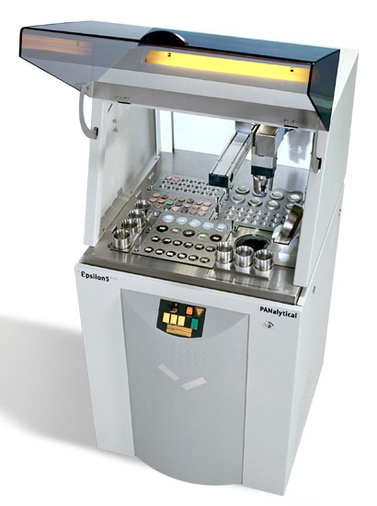
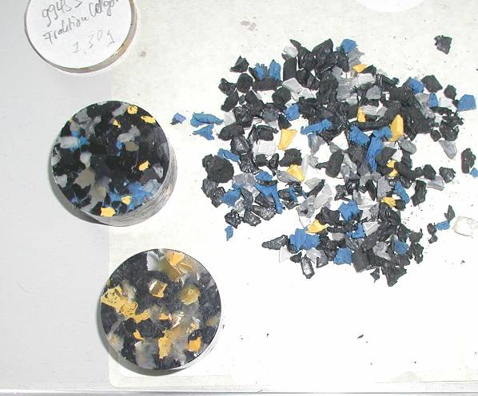
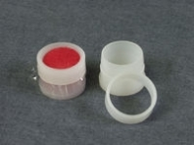
Screening of trace elements with ED-XRF
64

Slide 65
ED-XRF for trace elements in AFR
Advantages
Short analysis time and relatively simple sample preparation
Determination of main and trace elements in almost all materials, incl. traditional raw materials and correctives, alternative raw materials, combustibles, ashes
Ideal for fast screening of unknown (new) wastes
Disadvantage
The accuracy and lower detection limit is not sufficient for some critical elements (Hg, Tl, Cd). May not be accepted by authorities.
Rather poor performance on lighter elements (< Cl)
For ultimate precision, high efforts to prepare calibration curves (matrix influences)

Slide 66
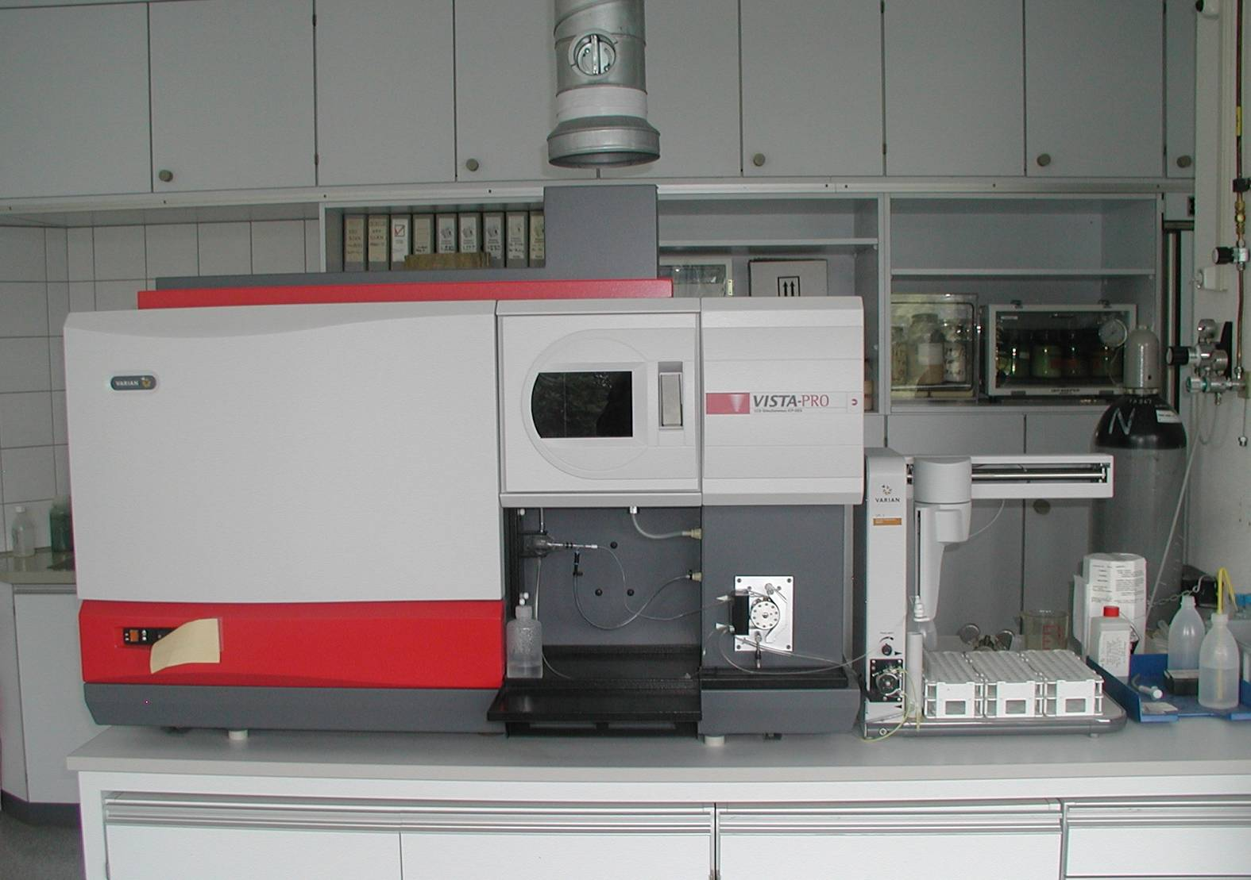
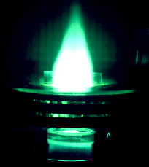
Accurate trace element analysis with ICP-OES
Plasma torch
66

Slide 67
Overview of analytical tools for main and trace elements
 | XRF |  | ICP |  | Complementary methods
 | WD | ED | Optical | MS
Elements
- Main (Ca, Si, Al, Fe) | ++ | + | ++ | -
- Minor (Hal, P, Sr ...) | ++ | + | + | +
- Trace (HM) | ++ | ++ | +++ | +++ | AAS
- Hg | - | - | - | (+) | Mercury Analyzer
Sample Presentation
- Untreated | x | x | o | o
- Crushed / Ground | x | x | o | o
- Liquid | x | x | o | o
- Digested / Solution | (x) | (x) | x | x
- Quantity | several grams |  | < 1 gram
Time | + | + | - | -
67

Slide 68
Standard Operating Procedures (SOP)
Written work instruction must be available for each test
Sampling, Sample preparation
Analytical measurement
Laboratory equipment management
Calibration schedule, Maintenance records
If possible, operating procedures shall refer to national or international standards.
If own methods are used, the SOP must be validated, i.e. it must be demonstrated that the method is suitable to obtain correct results compared to a reference method.
The SOP’s must be known and accessible for everybody in the laboratory.
Service contracts for selected equipment is recommended to assure rapid maintenance response.

Slide 69
Summary
AFR requires a sophisticated quality control scheme because of
Regulatory and permitting requirements
Employee‘s health and safety
Environmental risks and liabilities
Constant quality of our products
Careful AFR Source Qualification is a must
Control plans should reflect the appropriate balance between work load and accuracy of the result
Reduce errors from sampling and sample preparation
Provide appropriate AFR laboratory facilities
Make use of the experience available in Group companies and on Corporate level.
Consult the AFR Quality Manual
69

Slide 70
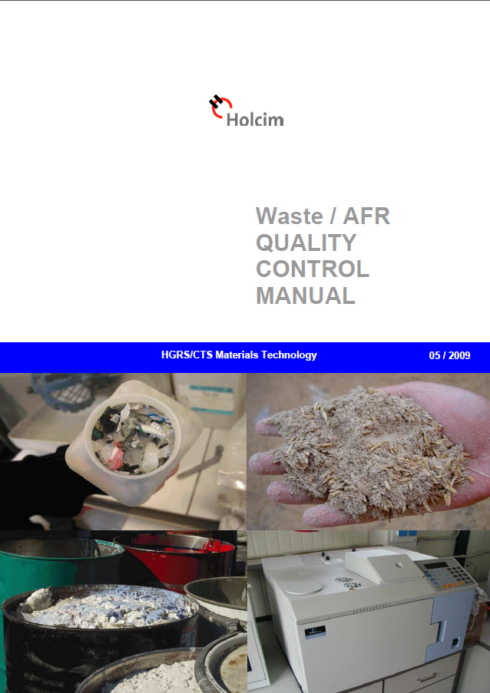
AFR Quality Control Manual: Last update in May, 2009
Covers waste / AFR quality control in both cement plants and platforms
Initially released by R. Stenger and a team of AFR experts from group companies in 2000
Content
AFR Quality Control Schemes
Setting up waste/AFR specifications
Sampling equipment and procedures
Laboratory equipment and procedures
Personnel requirements
70

Slide 71

Questions?

Slide 73
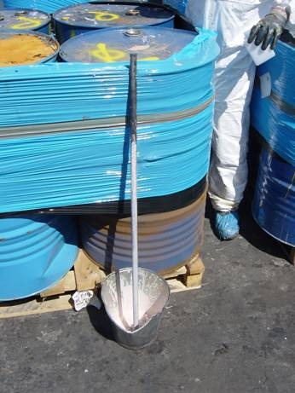
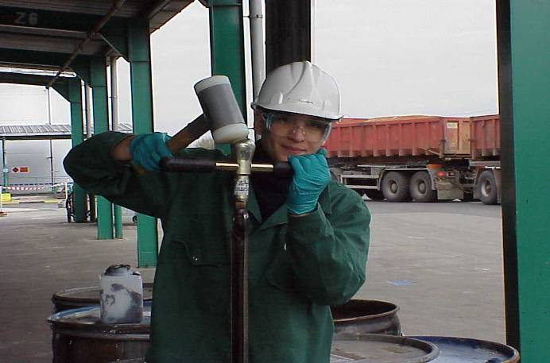
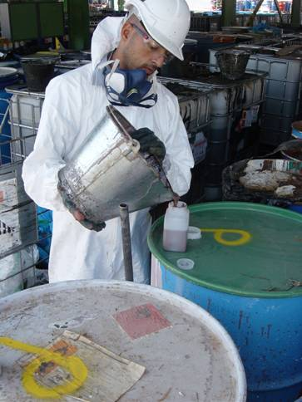

Sampling of small containers (platforms)
Core sampler
Copper tube
73

Slide 74
Critical organic compounds: Example PCB
PCB‘s (Poly Chlorinated Biphenyls): Mostly crystalline, colorless and chemically robust compounds. Highly lipophilic.
209 possible congeners from which about 20 - 60 are usually occurring in commercial products.
Chronically toxic, suspected to cause cancer, hormonal effects, enrichment in natural food chain. Precursor for Dioxins in combustion processes.
Limit in AFR: typically 50 ppm
74

Slide 75
Determination of PCB concentration in AFR‘s
Extraction from sample by organic solvents (hexane)
Detection with gas chromatograph, equipped with ECD or MS
Identification by comparison with reference standard (containing selected congeners)
ASTM D6160-98, DIN EN 15308
75

Slide 76
Method: Gaschromatography (GC)
Applications
Fingerprint analyses
Detection and identification of critical organic compounds (e.g. PCB, furanes, dioxines)
Frequently used detectors
FID (flame ionization detector)
MS (mass spectrometer)
ECD (electron capture detector)
76

Slide 77


Fluff preparation
Commercial wastes, Manufacturing wastes
Sorted municipal waste (packings)
Fluff
Altera Platform
Bulky municipal waste
Sorted material fractions for recycling
Heavy fractions to thermal power plant
LD plant: Fluff for co-processing
Local waste collectors
Bestsort: Pre-sorting
Altera: Pre-processing
77

Slide 78

Bestsort (incoming waste)
78

Slide 79

Bestsort (manual sorting)
79

Slide 80


Bestsort (sorted fractions)
80

Slide 81

Bestsort (improvised classifier)
81

Slide 82


Altera (process line)
82

Slide 83

Altera (cutting mills)
83

Slide 84
Fluff Preparation: Quality Control
Bestsort: Purely visual control, no sampling, no analysis. Automated removal of PVC material (NIR technology)
Altera:
Only visual acceptance control. Waste bags are labeled for traceability.
Production control: Weekly composite sample (10 L volume), analysed by external laboratory.
Lägerdorf:
Analysis of spot sample (1/shift) for NCV, H₂O, Cl
Full analysis of weekly composite.
Reporting of monthly composite to authorities
84

Slide 85
Fluff: Quality specifications
85

Slide 86
Fluff Preparation: Quality Control
Bestsort:
Purely visual acceptance control, no sampling, no analysis.
Automated detection and removal of PVC plastics with Near Infrared (NIR).
Quality control through manual sorting / waste picking.
Altera:
Visual acceptance control only, no analytical verification. Waste bales are labeled for traceability.
Production control: Weekly composite sample, analysed by external laboratory (10l sample).
Lägerdorf:
Analysis of spot sample (1/shift) for NCV, H₂O, Cl
Full analysis of weekly composite.
Reporting of monthly composite to authorities
86

